Slide 1
MongoDB
and document databases in general because I kind of got distracted….oops……

Slide 2



Slide 3
Brief Overview of MongoDB?
NoSQL Document Database
Stores JSON-style objects
High Performance
Embedding
Scalability
Sharding

Slide 4
Document Database
Database contains collections
You can almost think of them as tables…but don’t!
Collections contain documents
JSON like set of key-value pairs
Dynamic Schema!

Slide 5
What Does It Even Look Like?
{"city": "ACMAR", "loc": [-86.51557, 33.584132], "pop": 6055, "state": "AL", "_id": "35004"}
{"city": "ADAMSVILLE", "loc": [-86.959727, 33.588437], "pop": 10616, "state": "AL", "_id": "35005"}
{"city": "ADGER", "loc": [-87.167455, 33.434277], "pop": 3205, "state": "AL", "_id": "35006"}
{"city": "KEYSTONE", "loc": [-86.812861, 33.236868], "pop": 14218, "state": "AL", "_id": "35007"}
{"city": "NEW SITE", "loc": [-85.951086, 32.941445], "pop": 19942, "state": "AL", "_id": "35010"}
{"city": "ALPINE", "loc": [-86.208934, 33.331165], "pop": 3062, "state": "AL", "_id": "35014"}
{"city": "ARAB", "loc": [-86.489638, 34.328339], "pop": 13650, "state": "AL", "_id": "35016"}
{"city": "BAILEYTON", "loc": [-86.621299, 34.268298], "pop": 1781, "state": "AL", "_id": "35019"}
{"city": "BESSEMER", "loc": [-86.947547, 33.409002], "pop": 40549, "state": "AL", "_id": "35020"}
{"city": "HUEYTOWN", "loc": [-86.999607, 33.414625], "pop": 39677, "state": "AL", "_id": "35023“}
{"city": "BLOUNTSVILLE", "loc": [-86.568628, 34.092937], "pop": 9058, "state": "AL", "_id": "35031"}
{"city": "BREMEN", "loc": [-87.004281, 33.973664], "pop": 3448, "state": "AL", "_id": "35033"}
{"city": "BRENT", "loc": [-87.211387, 32.93567], "pop": 3791, "state": "AL", "_id": "35034"}
{"city": "BRIERFIELD", "loc": [-86.951672, 33.042747], "pop": 1282, "state": "AL", "_id": "35035"}
{"city": "CALERA", "loc": [-86.755987, 33.1098], "pop": 4675, "state": "AL", "_id": "35040"}
{"city": "CENTREVILLE", "loc": [-87.11924, 32.950324], "pop": 4902, "state": "AL", "_id": "35042"}
{"city": "CHELSEA", "loc": [-86.614132, 33.371582], "pop": 4781, "state": "AL", "_id": "35043"}
{"city": "COOSA PINES", "loc": [-86.337622, 33.266928], "pop": 7985, "state": "AL", "_id": "35044"}
{"city": "CLANTON", "loc": [-86.642472, 32.835532], "pop": 13990, "state": "AL", "_id": "35045"}
{"city": "CLEVELAND", "loc": [-86.559355, 33.992106], "pop": 2369, "state": "AL", "_id": "35049"}
{"city": "COLUMBIANA", "loc": [-86.616145, 33.176964], "pop": 4486, "state": "AL", "_id": "35051"}
{"city": "CRANE HILL", "loc": [-87.048395, 34.082117], "pop": 2270, "state": "AL", "_id": "35053"}
…

Slide 6
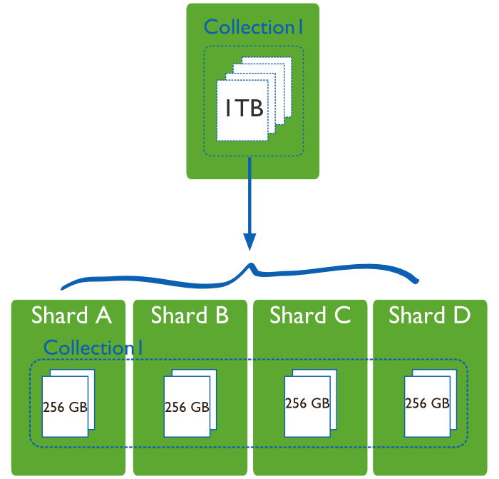

Scalability
Vertical Scaling
Bad ☹
Expensive
High performance systems are disproportionately more expensive
Sharding
Good ☺
Horizontal Scaling with multiple smaller machines
Mongo supports this out of the box

Slide 7
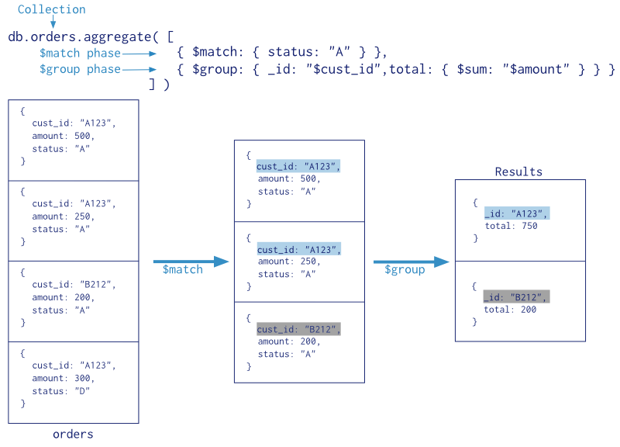
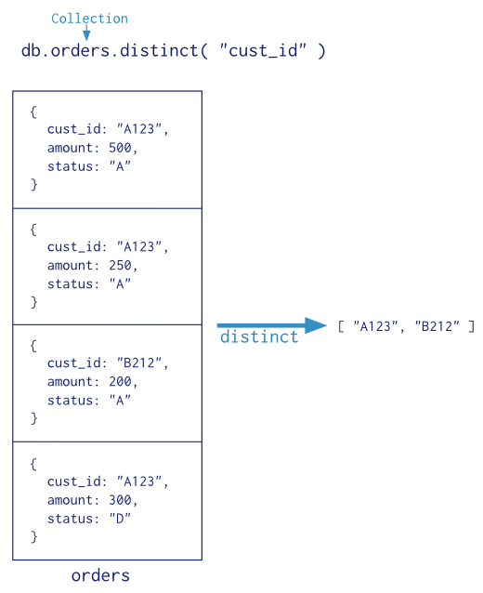
Aggregations
Aggregate
Single purpose Aggregates
Count
Distinct
Group

Slide 8
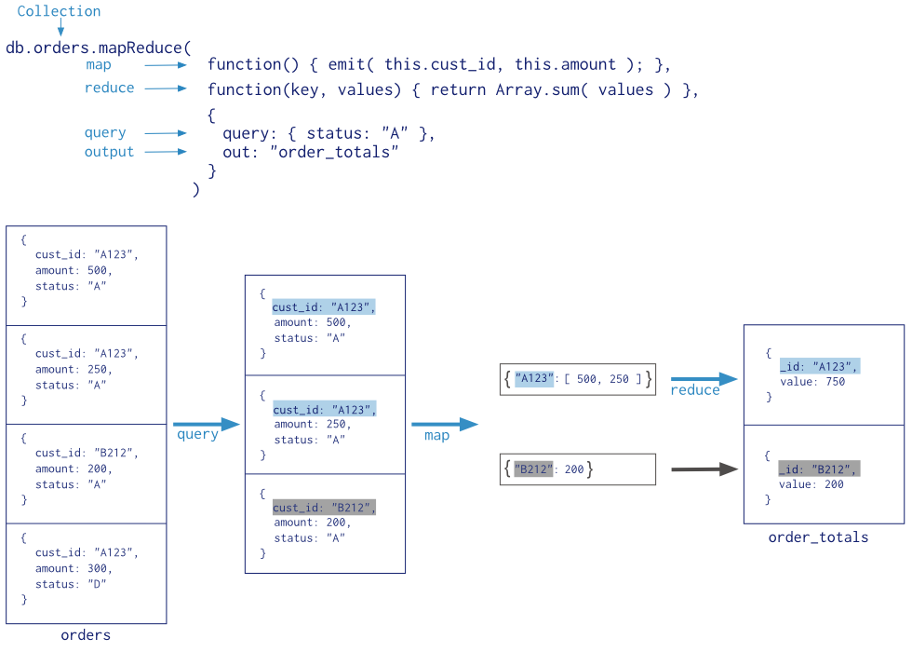
Aggregations

Slide 9
Example
{
_id : 1,
artist : “GirlStep”,
topSongs : [
{
name : “Game Over”,
otherArtists : [“X Sentinel”],
genre : “dubstep”
},
{
name : “WIP”,
isRemix : true,
originalArtist : “Eric Freeman”,
otherArtists : [“TIMarbury”],
genre : “dubstep”
},
{
name : “Take Over Control”,
genre : “dubstep”
isRemix : true,
originalArtist : “Afrojack”,
otherArtists: [“X Sentinel”]
}
],
genres : [“dubstep”, “house”, “electro”]
}

Slide 10


Slide 11
Cons
Data size is much larger
No flexibility with queries
No joins
No support for transactions
Stale data
There are only two hard things in Computer Science: cache invalidation and naming things. -- Phil Karlton
Easily lead to duplicate data

Slide 12
Duplicate Data Woes
{
_id : 1,
artist : “GirlStep”,
songs : [
{
name : “Game Over”,
otherArtists : [“X Sentinel”],
genre : “dubstep”
},
{
name : “WIP”,
isRemix : true,
originalArtist : “Eric Freeman”,
otherArtists : [“TIMarbury”],
genre : “dubstep”
},
{
name : “Take Over Control”,
genre : “dubstep”
isRemix : true,
originalArtist : “Afrojack”,
otherArtists: [“X Sentinel”]
}
],
genres : [“dubstep”, “house”, “electro”]
}
{
_id : 1,
artist : “GirlStep”,
topSongs : [
{
name : “Game Over”,
otherArtists : [
{
name : “X Sentinel”,
genres : [“dubstep”, “electro”, “trap”],
topSongs : [
{ name : “Game Over”, … },
{ name : “Scrapyard”, …},
{ name : “Make Me Anime”, … }
]
}
],
genre : “dubstep”
},
{
name : “WIP”,
isRemix : true,
originalArtist :
{
name : “Eric Freeman”,
genres : [“house”, “electronica”, “dubstep”],
topSongs : [
{ name : “I Wub Wub Wub You”, … },
{ name : “In Diana Jones”, … },
{ name : “Anti Dubstep”, … }
]
},
…
As a user, I want to hover over any artist’s name to see a quick profile of them as well
The “document” way would be to replace every “originalArtist” and “otherArtist” string with an object encapsulating them

Slide 13


Slide 14


Slide 15
Conclusion
I heard about MongoDB
I actually looked into it
Now I see it’s merits as a document store but not as a SQL Server replacement

